Slide 1
Types of Logical Data Models

Slide 2
A logical data model describes how data is logically organized and how different pieces of data are related to one another.
It provides a structure for representing data without focusing on exactly how the data is physically stored on a computer.
A logical data model helps answer questions such as:
How is the data organized?
How are different records related?
What rules govern those relationships?
How can users or applications navigate or retrieve the data?

Slide 3
Major Logical Data Models
Historically, three important logical data models are the hierarchical, network, and relational models.
Logical Data Model | Organization | Basic Structure
Hierarchical | Parent-child relationships | Tree
Network | Records connected through links | Network/graph
Relational | Data organized into relations | Tables

Slide 4
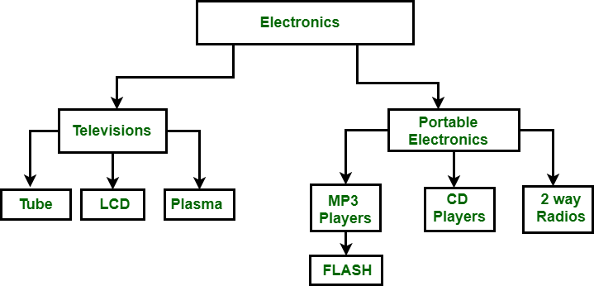
Hierarchical Model
The hierarchical data model is the oldest type of the data model. It was developed by IBM in 1968. It organizes data in a tree-like structure. Hierarchical model consists of the following :
It contains nodes which are connected by branches.
The topmost node is called the root node.
If there are multiple nodes appear at the top level, then these can be called root segments.
Each node has exactly one parent.
One parent may have many children.

Slide 5
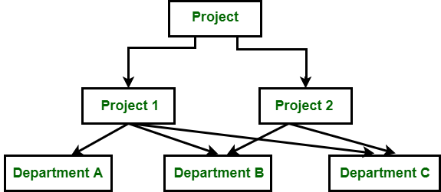
2. Network Model
The network model is an early database model in which data is organized as records connected to other records through links or relationships. It was developed before the relational model became dominant.
Unlike the hierarchical model, which organizes data as a tree where each child normally has only one parent, the network model allows a record to be connected to multiple parent records. This makes it better suited for representing more complex relationships.

Slide 6
3. Relational Data Model
The relational data model is a logical data model that organizes data into relations, commonly represented as tables. Each table represents a particular type of information, and relationships between tables are established primarily through keys.
The relational model was introduced by Edgar F. Codd in 1970 and became the foundation for most modern relational database management systems.

Slide 7
